Slide 1

Pocket Chef

Slide 2


Target Users
Users that these requirements could potentially originate from:
An older demographic is expected to use our app more, placing emphasis on ease of access, simplicity of design, and straightforward features that are both intuitive and well documented

Slide 3
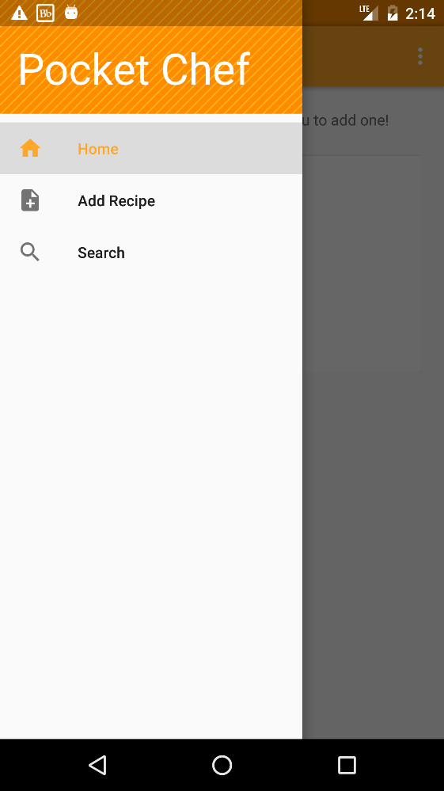

Minimum Functional Requirement
The Pocket Chef app shall hold and easily display recipes entered by the user
Description | All recipes will be listed on a page where a picture, and a title will be shown. Each recipe will be expandable to display more details.
Requires | A local database containing all recipes.

Slide 4
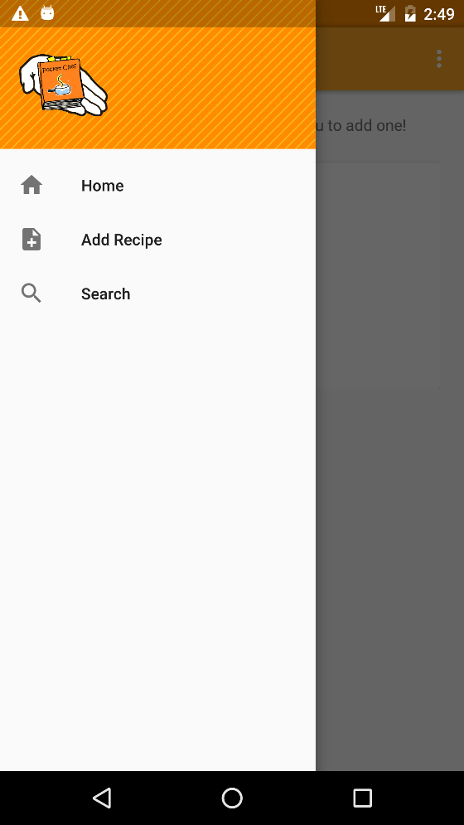
Minimum Functional Requirement
User should be able to add recipes to the app.
Description | Added recipes will include ingredients, steps to follow, and pictures of the final recipes.
Requires | Page for adding recipes with input fields. Access to the local database to save recipes.

Slide 5

Minimum Functional Requirement
User should be able to clearly view the entire contents of a previously added recipe
Description | Each recipe will be expandable to display ingredients, steps to follow, and pictures of the final recipes.
Requires | Database access to read a specific recipe. A separate page to clearly show all information for the recipe.

Slide 6

Functional Requirement
User should be able to edit and delete recipes
Description | A recipe, which can be viewed as an card, should have buttons or a expandable context menu with the option to open a text field to edit the recipe and an opposing option to delete the recipe from the database.
Requires | Access to the local database and a dialog allowing editing.
Pre-Condition | A pre-existing recipe.
Post-Condition | Either an updated recipe entry or the removal of the record from the database.
Side Effects | If deleted, the function will remove other rows from different tables that depend on the main recipe entry.

Slide 7
Functional Requirement
User should be able to search for individual recipes by name of recipe
Description | A text field near the top of the home page should allow the user to type keywords, which will search for recipes in the database based on those keywords.
Requires | Access to the local database and a text field.
Pre-Condition | A pre-existing recipe.
Post-Condition | A list of cards showing the results of the search, if there are any.

Slide 8

Functional Requirement
User should be able to back up stored recipes and retrieve recipes in case of data loss
Description | A friendly interface within the settings of the app should allow the user to back up the local database to the location of their choice so that they may copy it to another device in case of device failure.
Requires | The local database and file access permissions from the user.
Pre-Condition | An existing database.
Post-Condition | A copy of the database that is in the desired location.
Side Effects | Depending on how the database system serves information, it may leave the database in read-only mode if we have to close existing connections.

Slide 9
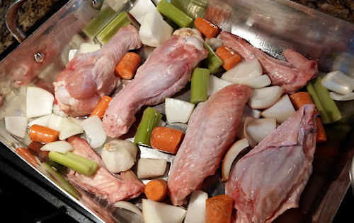
Functional Requirement
User should be able to perform an advanced search by category of food and ingredients used
Description | A text field near the top of the home page should allow the user to enter categories of food and ingredients to search the recipes in the database.
Requires | Advanced algorithms to filter a database to a specific criteria.

Slide 10
Non-Functional Requirement
User should be able to depend on the quick performance of the app
Description | The app should be quickly responsive to all commands of the user, enabling the user to easily navigate and use the app.
Requires | Reliable with few to no errors.

Slide 11
Future Functional Requirements
Users should be able to send and receive recipes between devices
Users should be able to modify app settings to assist with user preferences

